Slide 1

Azure Chat Bots
Deep Dive

Slide 2

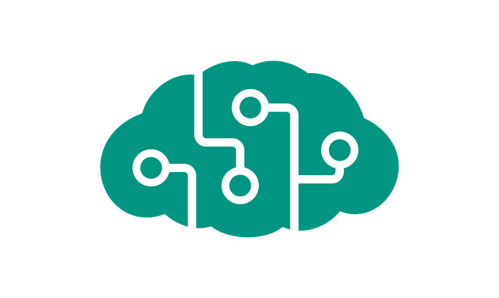
The Rise of AI

Slide 3
The Rise of AI
28 Years Old, Female
Language – English
Sentiment – Neutral
Seen Before – Yes (Voice, Face)
Context – Good Places to Eat
?
?
I would like to order some food
?
?
?
Hey, Good to See you back…
Would you like to checkout the new Italian Restaurant in the city and try out “Pepperoni Pizza” there ?
Search
Sentiment (face, text)
recommendations
Search
Sounds Good, Book It !
Book
Sentiment (face → Happy)
Context – Italian Restaurant Booking
I am Glad that I am able to help you today. Have a good day !

Slide 4
Agenda Topics
1
2
3
4
5
Introduction
The What, How and Why of Chat Bot
What are Bots
Microsoft Chat Bot Anatomy
Hello Bot
10
6
8
9
User Input Bot
Waterfall Bot
Adaptive Card
Cortona Bot

Slide 5
Who are we ?
Srikar Kumar Bhaskara
Azure Data + AI Solutions Architect
Founder & CTO @
JumpStartNinja Technologies
100 % Azure AI Focused
MIT Certified Data Scientist
Linked In : https://www.linkedin.com/in/srikarkumar
Kevin McCarty
30+ years in the industry with 20+ years of experience in data science and data analytics
Azure Expert
Microsoft Certified Trainer
Linked in: https://www.linkedin.com/in/kevin-mccarty

Slide 6
The What, How and Why of Cognitive Services

Slide 7
Cortana Intelligence Suite | Overview
Information Management
Big Data Stores
Machine Learning and Analytics
Intelligence
Data Sources
People
Data Factory
Data Lake Store
Machine Learning
Cognitive Services
Data Catalog
SQL Data
Warehouse
Data Lake Analytics
Bot Framework
Web
Apps
HDInsight
(Hadoop and Spark)
Event Hubs
Cortana
Mobile
Apps
Stream Analytics
Bots
Dashboards & Visualizations
Sensors and devices
Power BI
Automated Systems
Data
Intelligence
Action
Notes:
Cortana Intelligence Suite delivers an end-to-end platform with integrated and comprehensive set of tools and services to help you build intelligent applications that let you easily take advantage of Advanced Intelligence.
First Cortana Intelligence Suite provides services to bring data in, so that you can analyze it. It provides information management capabilities like Azure Data Factory so that you can pull data from any source (relational DB like SQL or non-relational ones like your Hadoop cluster) in an automated and scheduled way, while performing the necessary data transforms (like setting certain data columns as dates vs. currency etc.). Think ETL (Extract, Transform, Load) in the cloud. Event hub does the same for IoT type ingestion of data that streams in from lots of end points.
The data brought in then can be persisted in flexible big data storage services like Data Lake and Azure SQL DW.
You can then use a wide range of analytics services from Azure ML to Azure HDInsight to Azure Stream Analytics to analyze the data that are stored in the big data storage. This means you can create analytics services and models specific to your business need (say real time demand forecasting).
The resultant analytics services and models created by taking these steps can then be surfaced as interactive dashboards and visualizations via Power BI
These same analytics services and models created can also be integrated into various different UI (web apps or mobile apps or rich client apps) as well as via integrations with Cortana, so end users can naturally interact with them via speech etc., and so that end users can get proactively be notified by Cortana if the analytics model finds a new anomaly (unusual growth in certain product purchases- in the case of real time demand forecasting example given above) or whatever deserves the attention of the business users.

Slide 8
What is Bot ?
Bots are users embedded inside a communication platform, But the users are not human but software that interact with the external world and help perform their work or day to day activities
A piece of program that acts like the “First Class Citizen” and provides all support for a particular line of business
A business shift from Desktop to Web to Mobile App to Message Apps
Just another Cross Hair Syndrome Effect ?
What do you think ?

Slide 9
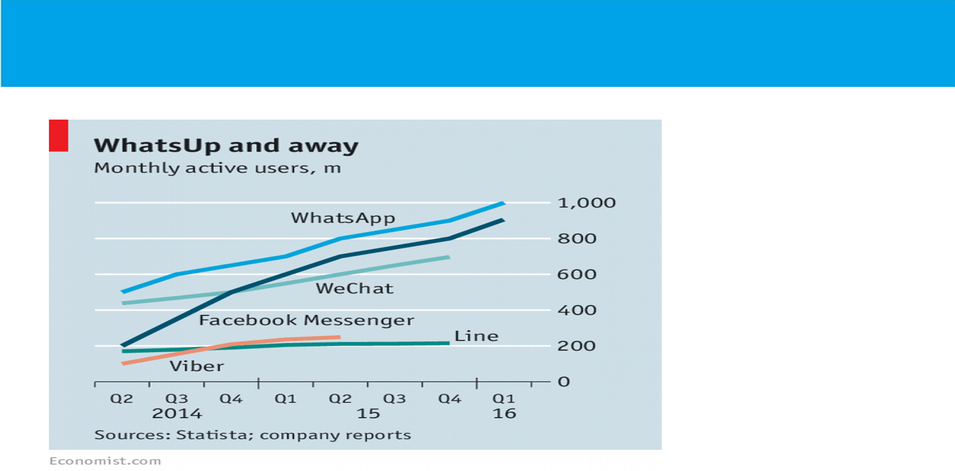

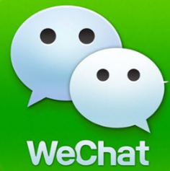


App Economy to Bot Economy

Slide 10
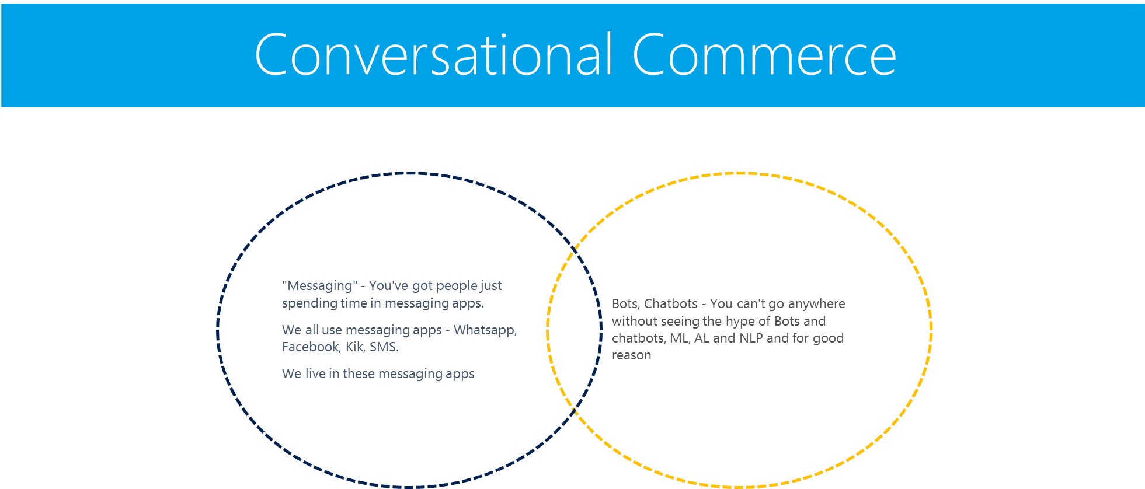

Slide 11
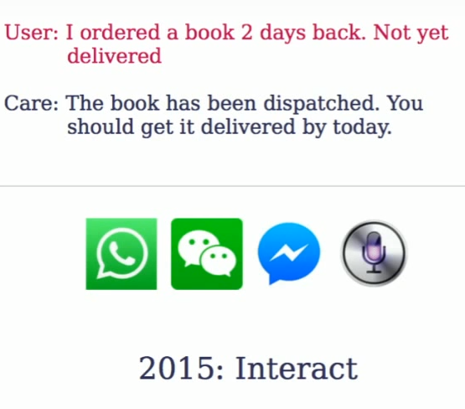
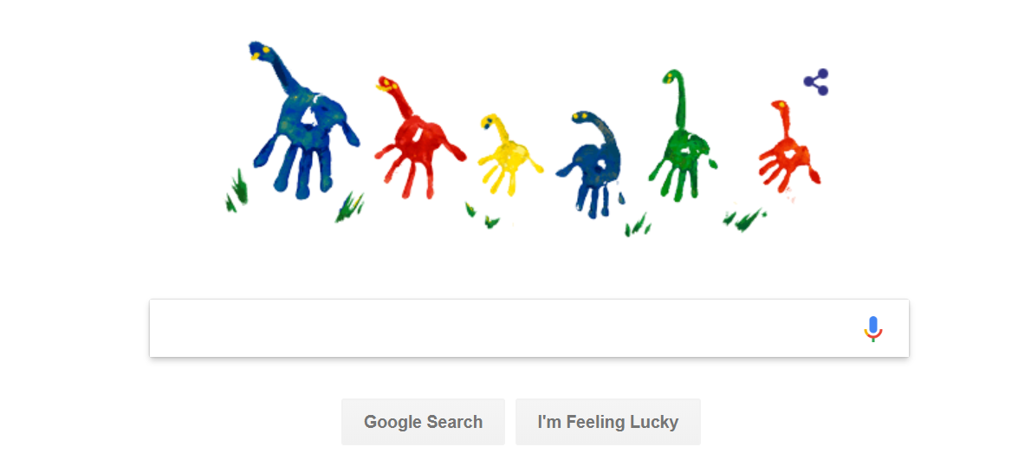
Users are tired of Search Bars
2005: Seek Reponse

Slide 12
When to Replace Search Bar ?
Book a cab ?
Order Food ?
Get the status of your Order ?
Pay your Phone Bill ?
Plan and Book a Holiday Package ?
Resolving Issue in a services that’s being provided ?
Replace FAQs ?

Slide 13
Four Levers of a Super Experience Bot
Extract the Intent
Build the Context
Personalize and Assist
Provide Relevant Results

Slide 14
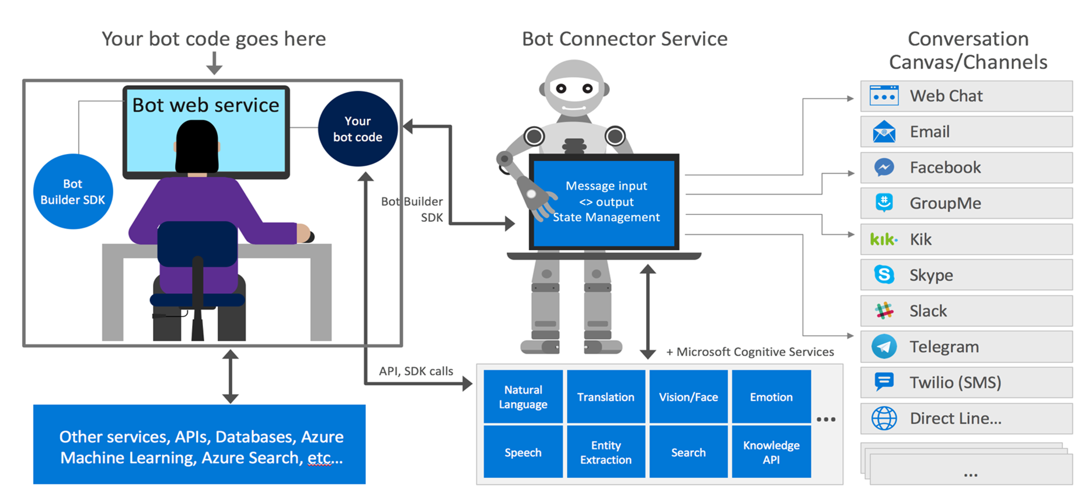
The Anatomy of Microsoft Bot

Slide 15
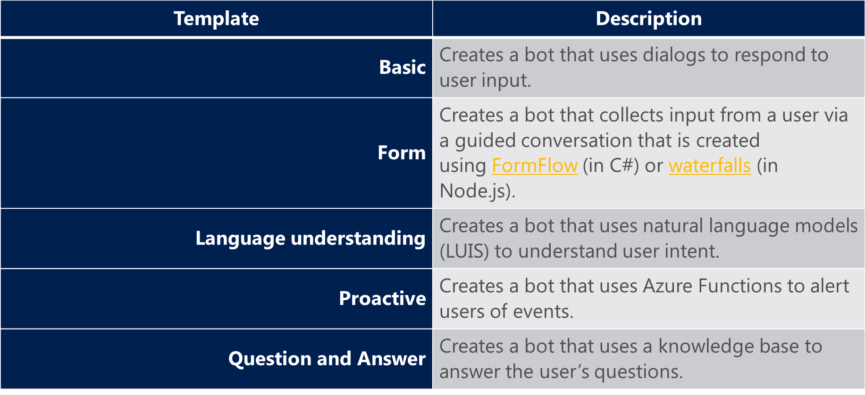
Types of Bot Service

Slide 16


“Hello World” Bot Demo
Exploring the Bot Using Not Emulator
Get Bot Subscription Key
Get the Git Code to your DSVM
Deploy it on Azure
Context of the Bot Demo
Simple “Hello Word” Demo
Explore the Results
Notes:
Lessons learnt: release internally early.
2 weeks of investigation
- Git repo created on 2/11 (only 9 months ago)
- First Azure related commit on 2/20
3 months of dev

Slide 17

User Input Bot 1 Demo
Exploring the Bot Using Not Emulator
Get Bot Subscription Key
Get the Git Code to your DSVM
Deploy it on Azure
Prompting User for an input as text
Responding back to the user with stored value
Context of the Bot Demo
Explore the Results
Notes:
Lessons learnt: release internally early.
2 weeks of investigation
- Git repo created on 2/11 (only 9 months ago)
- First Azure related commit on 2/20
3 months of dev

Slide 18
User Input Bot 2 Demo
Exploring the Bot Using Not Emulator
Get Bot Subscription Key
Get the Git Code to your DSVM
Deploy it on Azure
Prompting User for an input as a Choice
Responding back to the user with stored value
Context of the Bot Demo
Explore the Results
Notes:
Lessons learnt: release internally early.
2 weeks of investigation
- Git repo created on 2/11 (only 9 months ago)
- First Azure related commit on 2/20
3 months of dev

Slide 19

Waterfall Bot Demo
Exploring the Bot Using Not Emulator
Get Bot Subscription Key
Get the Git Code to your DSVM
Deploy it on Azure
Prompting the User for Series of Inputs
Responding back to the user with the summary of stored values
Context of the Bot Demo
Explore the Results
Notes:
Lessons learnt: release internally early.
2 weeks of investigation
- Git repo created on 2/11 (only 9 months ago)
- First Azure related commit on 2/20
3 months of dev

Slide 20

Adaptive Card Bot
Exploring the Bot Using Not Emulator
Get Bot Subscription Key
Get the Git Code to your DSVM
Deploy it on Azure
Building Beautiful UI to Bot
Context of the Bot Demo
Explore the Results
Notes:
Lessons learnt: release internally early.
2 weeks of investigation
- Git repo created on 2/11 (only 9 months ago)
- First Azure related commit on 2/20
3 months of dev

Slide 21

Cortana Bot Demo
Exploring the Bot Using Not Emulator
Get Bot Subscription Key
Get the Git Code to your DSVM
Deploy it on Azure
Context of the Bot Demo
Analyze Image
Find a Celebrity
Find a Landmark
Explore the Results
Notes:
Lessons learnt: release internally early.
2 weeks of investigation
- Git repo created on 2/11 (only 9 months ago)
- First Azure related commit on 2/20
3 months of dev

